Slide 1
OSRM Brief Introduction and Demo
Jay Zhang - Jan 2020

Slide 2
Agenda
OSRM Brief Introduction
OSRM Current Progress In Telenav
Demo
Q & A

Slide 3
OSRM Brief Introduction

Slide 4
OSRM - Open Source Routing Machine
Open source by Mapbox, widely used by MapBox/Uber/PInterest/Foursquare.
osrm-backend
High performance routing engine written in C++14 designed to run on OpenStreetMap data.
osrm-frontend
The web frontend of osrm-backend, builds heavily on top of Leaflet.
The frontend served at https://map.project-osrm.org

Slide 5
OSRM-backend services
Nearest - Snaps coordinates to the street network and returns the nearest matches
Route - Finds the fastest route between coordinates
Table - Computes the duration or distances of the fastest route between all pairs of supplied coordinates
Match - Snaps noisy GPS traces to the road network in the most plausible way
Trip - Solves the Traveling Salesman Problem using a greedy heuristic
Tile - Generates Mapbox Vector Tiles with internal routing metadata
available via HTTP API, C++ library interface and NodeJs wrapper

Slide 6
OSRM Algorithms
 | Contraction Hierarchies (CH) | Multi-Level Dijkstra (MLD)
Paper |  | Customizable Route Planning
Pre-processing (i.e. data compilation) | Very slow | Slow
Query | Extremely fast | Fast
Dynamic data injection (e.g. traffic) | Hard (too slow) | Minutes per injection(customize)
Processing Pipeline | osrm-extract osrm-contract osrm-routed | osrm-extract osrm-partition osrm-customize osrm-routed
* We’re focusing on the MLD algorithm.

Slide 7

OSRM Characteristics - Fast
1 Origin
0.127
seconds
to
60 Destinations
(radius 15 km)

Slide 8
OSRM Characteristics – Cloud Only Solution
Compiled Data Format
OSRM internal defined
NA Compiled Data Size
~ 43GB

Slide 9
OSRM Characteristics – Edge-expanded Graph
osrm-extract
Parse OSM
Compress graph (Merge single-connect links)
Generate Edge-expanded graph
Understanding OSRM Graph Representation

Slide 10
OSRM Characteristics – Lua
Lua codes as Profiles, no more configuration.
Implemented cost model logic in Lua.
How OSRM Calculate Weight and Duration
Interaction Between C++ and Lua In OSRM

Slide 11
OSRM Current Progress In Telenav

Slide 12
What we did/doing
Compile Telenav UniDB PBF
Route Quality Benchmark & Tuning
OSRM with traffic
DirectionAdapter - Route Playback, Detour service
Pipeline for Build, Data Compilation and Test
Kubernetes based Deployment

Slide 13
Compile Telenav UniDB PBF
Basic structures of UniDB/OSM PBF are very similar.
Fixed NodeID/WayID overflow.
NodeID/WayID too long due to special rule in UniDB.(e.g. last 100 of WayID)

Slide 14
Route Quality Benchmark & Tuning
About 83% acceptable
No Traffic
Tested/analyzed NA 600 cases include short/medium/long distance.
Known Issues
Not support complex restriction
Get off ramp and back on instead of staying on highway
With traffic quality is bad
Speed NOT correct in Telenav UniDB PBF
Different tag representation in OSM/UniDB PBF

Slide 15
Route Quality Tuning – PBF Difference
 | OSM PBF | UniDB PBF | Comment
speed_unit | maxspeed=50 mph | maxspeed=50 speed_unit=M | Fixed in Lua profile.
stopsign | highway=stop (on Node) | traffic_sign=stop (in relation) | Possible to improve
traffic_signals | highway=traffic_signals (on Node) | type=traffic_signals (in relation) | Possible to improve
highway=xxx | Key tag in OSM, OSRM uses it to mapping static speed heavily. | Designed for display, may NOT accurate enough. | Is it possible to make some improvement on UniDB?

Slide 16
OSRM with traffic
Strategy | Time efficiency | Effect
customize full region traffic into OSRM data | Per 15~20 minutes | Route Duration
customize blocking-only traffic into OSRM data | Per 10 minutes | Route
Alternatives ranking calculate N alternatives calculate weight/duration for these N alternatives rank by weight to get best one(or several) | Real-time | Route Duration

Slide 17
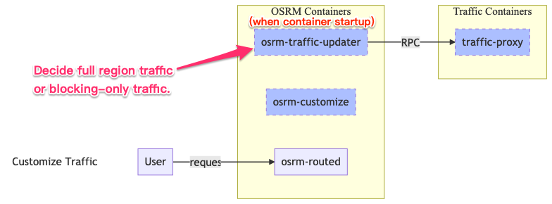
OSRM with traffic – Customize

Slide 18
OSRM with traffic – Customize

Slide 19
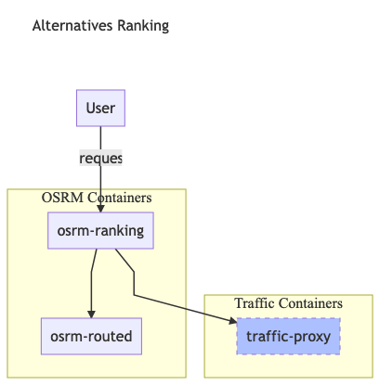
OSRM with traffic – Alternatives Ranking
calculate N alternatives
calculate weight/duration for these N alternatives
rank by weight to get best one(or several)
Known Issue
N only allow max 3 for now

Slide 20
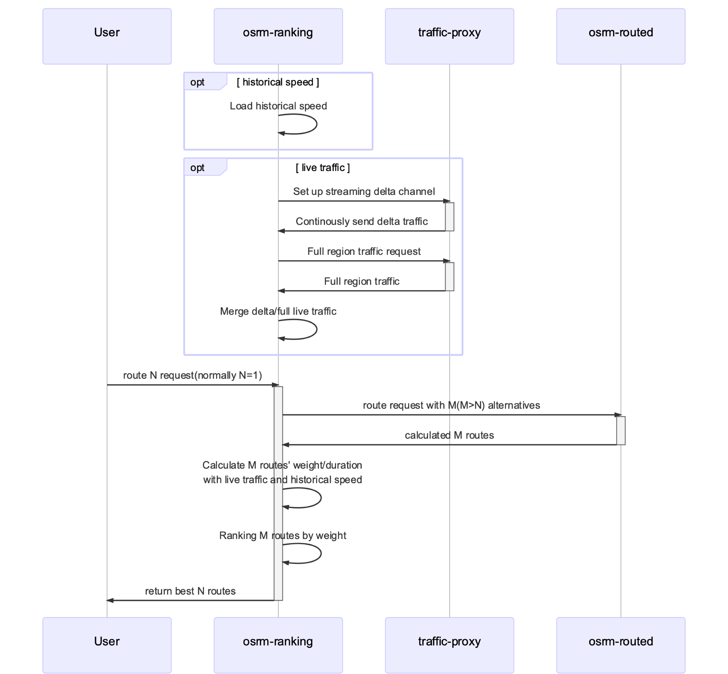
OSRM with traffic – Alternatives Ranking
Cached WayID->NodeIDs mapping
TrafficCache indexed by Edge(FromNodeID, ToNodeID)

Slide 21
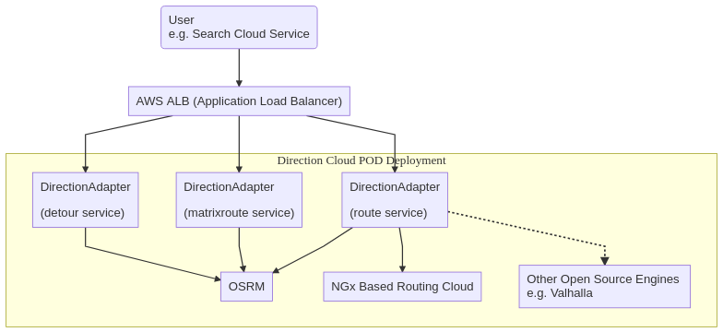
DirectionAdapter

Slide 22
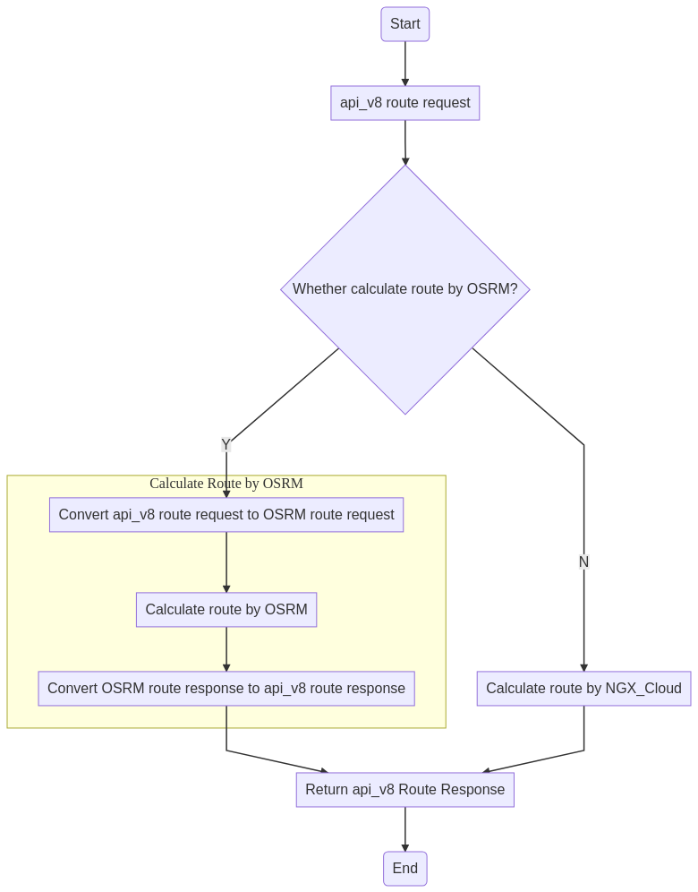
DirectionAdapter - Route Playback
Two possible ways to generate api_v8 response
(OSRM and NGx use same PBF)
Map Matching
Matching OSRM Geometries on NGX_Cloud
Table Look-up
PBF NodeIDs→NGX EdgeIDs
(OSRM can output all PBF NodeIDs of Route)

Slide 23
DirectionAdapter - Route Playback
Known Issue/Risk
Not fast enough for long route
E.g. 1000 km case(origin=40.669000,-111.944745&destination=39.126285,-121.617578) needs about 700 ms in total(match 189ms, routing 251 ms, guidance 259 ms)
Matching error on some complex case
Table look-up may not fast enough too due to huge table size
UniDB NA has about 60 millions Ways, 560 millions Nodes

Slide 24
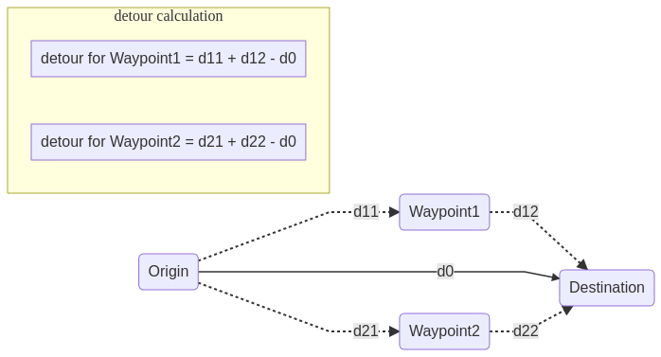
DirectionAdapter - Detour
Designed but NOT implemented yet

Slide 25
Planning (next 2 quarters)
Route Quality Tuning
No traffic
With traffic
UniDB/OSM Data Analysis
Understanding OSRM Compiled Map Data Files
Table Service Benchmark
Predictive(Historical) Speed – osrm-ranking
DirectionAdapter - Route Playback, Detour service
Visualized Debugging Tool
Deployment: microservices orchestration & pipeline

Slide 26
Demo

Slide 27
Demo System Architecture
OSRM Demo 2020.1

Slide 28
Q & A

Slide 29
References
Github (welcome watching/star)
https://github.com/Telenav/osrm-backend
https://github.com/Telenav/open-source-spec
Wiki
OSRM Research Main Page

Slide 30
Thanks!

